Slide 1
Who am I?
My name is Baran BÜYÜK, 38 years old. I’m living in İstanbul. I’m married and have one little princes.
What did I graduate from?
I’m graduate at Gaziantep University
Where do I work?
Introduction
I’m working at Solvia Digital Solutions as Java Unit Manager.
How could you contact me?
Via Linkedin: https://www.linkedin.com/baranbuyuk
Via Gmail : baranbuyuk@gmail.com
Via Mobile Phone: +90 531 336 54 91

Slide 2
First Week
Second Week
Intellij Idea
OOP Concepts with Java
SOLID Principles
Maven Build Tool
Spring IoC, DI
Traditional Spring MVC and Configuration
Spring Bean Lifecycle
Spring Boot and Configuration
Third Week
Fourth Week
Restful Approcahs
Restful HTTP Methods
Spring Restful Services
Relation Database Management Systems ( PostgreSQL & H2DB)
Spring Data Architecture
Spring Data JPA Repositories
Hibernate ( JPA Implementation )
Transactions and Transaction Management
Contents
Fifth Week
Sixth -Seventh Week
Exception Handling via Spring
Spring Security & Json Web Token ( JWT )
Spring Boot Test ( Unit and Integration )
Docker (Basic)
Jenkins
Graduation Project ( Interactive Coding )

Slide 3
Setting up Intellij Idea
If you have already Intellij Idea Editor, you can jump theese steps.
I’m using Mack Book Pro, for that reason, all these steps which are below prepared for Mac OS.
I’m not going to mention about how can you download Java ( JDK ) and set up it. This session not about it. If you don’t have JDK and don’t you know set up,
please google it ☺
Download
Go to https://www.jetbrains.com/idea/download and download it.
Please go to the folder where downladed and in order to install application please click the installation package. The installer will open after that please just click
next buttons. We don’t need to install any extra extension. The default extensions enouhg to us.
First Week
Intellij Idea
We’re going to talk about the features of intellij idea editor in the class.
Topics
Welcome Screen
Plugins / Extensions
Project Section in the editor
Structure Section in the editor
Preferences Screen
Database and Maven Section
Debug Mode
Find / Find and Replace Tool
Short-Cuts

Slide 4
What is OOP? ( Object Oritend Programming )
Object Oriented Programming is programming paradigm based on the concept of “objects, which can contain data and code; data in the form of fields (often known as
attiribute or properties) and code, in the form produces (often known as methods).”
A feature of objects is that an object's own procedures can access and often modify the data fields of itself (objects have a notion of this or self).
In OOP, computer programs are designed by making them out of objects that interact with one another.
OOP languages are diverse, but the most popular ones are class-based, meaning that objects are instances of classes, which also determine their types.
Many of the most widely used programming languages (such as C++, Java, Python, etc.) are multi-paradigm and they support object-oriented programming to a greater or lesser degree, typically in combination with imperative, procedural programming.
Significant object-oriented languages include: Java, C++, C#, Python, R, PHP, Visual Basic.NET, JavaScript, Ruby, Perl, SIMSCRIPT, Object Pascal, Objective C, Dart, Swift, Scala, Kotlin, Common Lisp, MATLAB, and Smalltalk.
First Week
OOP
What is the structure of object-oriented programming?
The structure, or building blocks, of object-oriented programming include following:
Classes are user-defined data types act as the blueprint for individual objects, attributes and methods.
Objects are instance of a class created with specifically defined data. Objects can correspond to real-world objects or an abstract entity. When class is defined initially, the description is the only object that is defined.
Methods are functions that are defined inside a class that describe the behaviors of an object. Each method contained in class definition starts with a reference to an instance object. Additionally, the subroutines contained in an object are called instance methods. Programmers use methods for reusability or keeping functionality encapsulated inside one onject at time.
Attributes are defined in class template are represent at the state of an object. Objects will have data stored in the attributes field. Class attributes belong the class itself.

Slide 5
What are the main principles of OOP?
Object-oriented programming is based on the following principles:
Encapsulation - This principle states that all important information is contained inside an object and only select information is exposed. The implementation and state of each object are privately held inside a defined class. Other objects do not have access to this class or the authority to make changes. They are only able to call a list of public functions or methods. This characteristic of data hiding provides greater program security and avoids unintended data corruption
Abstraction - Objects only reveal internal mechanisms that are relevant for the use of other objects, hiding any unnecessary implementation code. The derived class can have its functionality extended. This concept can help developers more easily make additional changes or additions over time.
Inheritance - Classes can reuse code from other classes. Relationships and subclasses between objects can be assigned, enabling developers to reuse common logic while still maintaining a unique hierarchy. This property of OOP forces a more thorough data analysis, reduces development time and ensures a higher level of accuracy.
Polymorphism - Objects are designed to share behaviors and they can take on more than one form. The program will determine which meaning or usage is necessary for each execution of that object from a parent class, reducing the need to duplicate code. A child class is then created, which extends the functionality of the parent class. Polymorphism allows different types of objects to pass through the same interface.
First Week
OOP
What are the benefits of OOP?
Modularity - Encapsulation enables objects to be self-contained, making troubleshooting and collaborative development easier.
Reusability. Code can be reused through inheritance, meaning a team does not have to write the same code multiple times.
Productivity. Programmers can construct new programs quicker through the use of multiple libraries and reusable code.
Easily upgradable and scalable. Programmers can implement system functionalities independently.
Interface descriptions. Descriptions of external systems are simple, due to message passing techniques that are used for objects communication.
Security. Using encapsulation and abstraction, complex code is hidden, software maintenance is easier and internet protocols are protected.
Flexibility. Polymorphism enables a single function to adapt to the class it is placed in. Different objects can also pass through the same interface.
Let’s look at the good examples for OOP principles.

Slide 6
What is SOLID Principles?
What does the SOLID principles actually mean? Well, it’s just an acronym of the five principles listed as below.
S – Single Responsibility Principle
O – Open / Closed Principle
L – Liskov’s Substitution Principle
I – Interface Segregation Principle
D – Dependency Inversion Principle
Let’s try to understand what all these principles means, one by one with examples.
Single Responsibility Principle
First Week
SOLID Principles
The name itself suggest that the “class should be having one and only one responsibility”. What does it mean? Well, let’s take the class A which does the following operations.
Open a database connection
Fetch data from database
Write the data in an external file
The issue with this class is that it handles lot of operations. Suppose any of the following change happens in future.
New database
Adopt ORM to manage queries on database
Change in the output structure
So, in all the cases the above class would be changed. Which might affect the implementation of the other two operations as well. So ideally according to SRP there should be three classes each having the single responsibility.
Let’s look at the good example in code.

Slide 7
Open / Closed Principle
This principle suggests that “classes should be open for extension but closed for modification”.
What is means is that if the class A is written by the developer AA, and if the developer BB wants some modification on that then developer BB should be easily do that by extending class A, but not by modifying class A.
Let’s look at the good example in code.
Liskov’s Subsitition Principle
First Week
SOLID Principles
This principle suggests that “parent classes should be easily substituted with their child classes without blowing up the application”. Let’s take following example to understand this.
The overridden method shouldn’t remain empty
The overridden method shouldn’t throw an error
Base class or interface behavior should not go for modification (rework) as because of derived class behaviors.
Let’s look at the good example in code.

Slide 8
Interface Segregation Principle
This principle suggests that “many client specific interfaces are better than one general interface”.
This is the first principle which is applied on interface, all the above three principles applies on classes. Let’s take following example to understand this principle.
Let’s look at the good example in code.
Dependency Inversion Principle
First Week
SOLID Principles
This principle suggest that “classes should depend on abstraction but not on concretion”.
What does it mean that we should be having object of interface which helps us to communicate with the concrete classes. What do we gain from this is, we hide the actual implementation of class A from the class B. So, if class A changes the class B doesn’t need to care or know about the changes.
Let’s look at the good example in code.

Slide 9
Singleton Design Pattern
Singleton pattern is one of the simplest design patterns in Java. This type of design pattern comes under creational pattern as this pattern provides one of the best ways to create an object.
This pattern involves a single class which is responsible to create an object while making sure that only single object gets created. This class provides a way to access its only object which can be accessed directly without need to instantiate the object of the class.
There are 3 ways to create Singleton design pattern in the Java.
Lazy initialization, non-thread-safe - This is the classical version, but it's not thread-safe. If more than one thread attempts to access instance at the same time, more than one instance may be created
Non-lazy initialization, thread-safe - This is the simplest thread-safe version, but it does not support lazy initialization.
Lazy initialization, thread-safe - This version supports both properties but has performance problems. Once a thread uses a singleton instance, the others have to wait because of the lock.
Design Pattern of the Day
Singleton
Let’s look how can we create Singleton Design Patterns
There is an issue at all examples, what is that? I’m gonna buy a ice-cream with chocolate to who will able to find the solution ☺

Slide 10
What is Spring Framework?
The Spring Framework is an open-source Java application framework originally developed based on the principles of dependency injection (DI) and inversion of control (IoC).
The Spring Framework has grown over years from just being an Inversion of control container, and currently includes several modules that provide range of services like Aspect-oriented programming, Data access, Transaction management, Model–view–controller, Authentication and authorization, Messaging, and Testing. You can have a look at all of these Spring projects @ spring.io/projects. The core module is the Spring Framework and most other modules are dependent on this module.
Spring provides autowiring capabilities through which you can simply specify the interface type and Spring can find an actual type at runtime, provided there are no conflicts.
Spring has become a popular alternative to the Enterprise JavaBean (EJB) model.
Second Week
Spring Framework
The Spring Framework Container
A container creates and manages your components, and even provides some services to components managed in its environment, such as transaction management, persistence and security etc.
Examples of containers from Java EE are Servlet container (or web container) that manages Servlets, JSPs, Filters etc. and EJB container that manages EJB components like session beans, message driven beans and entity beans.
Spring framework is a also container, as application components can be created and managed, and can be wired together. The spring framework even provides middleware services such as transaction management, dependency injection, persistence, aspect-oriented programming and security.
Spring framework is considered a lightweight container compared to EJBs, as it manages the components and provides services without requiring application code to depend on its own API, and also doesn’t need to be deployed into a full-featured application server, as in the case of EJBs.

Slide 11
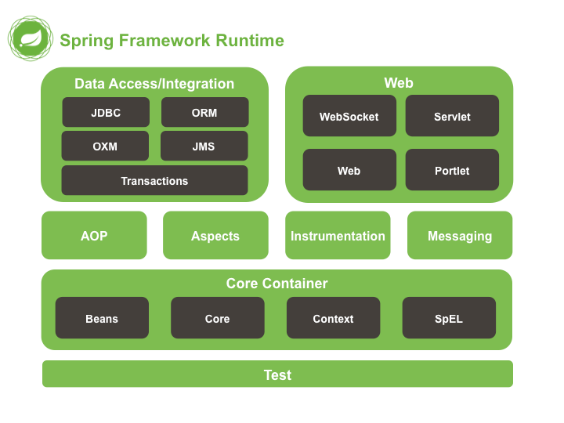
Various Spring modules can be grouped together into the following categories.
Spring Core modules – IoC Container, Events, Resources, i18n, Validation, Data Binding, Type Conversion, SpEL, AOP.
Spring Test modules – Mock Objects, TestContext Framework, Spring MVC Test, WebTestClient.
Data Access Modules – Transactions, DAO Support, JDBC, O/R Mapping, XML Marshalling.
Web Servlet modules – Spring MVC, WebSocket, SockJS, STOMP Messaging.
Reactive Web modules – Spring WebFlux, WebClient, WebSocket.
Integration modules – Remoting, JMS, JCA, JMX, Email, Tasks, Scheduling, Caching.
Second Week
Spring Framework

Slide 12
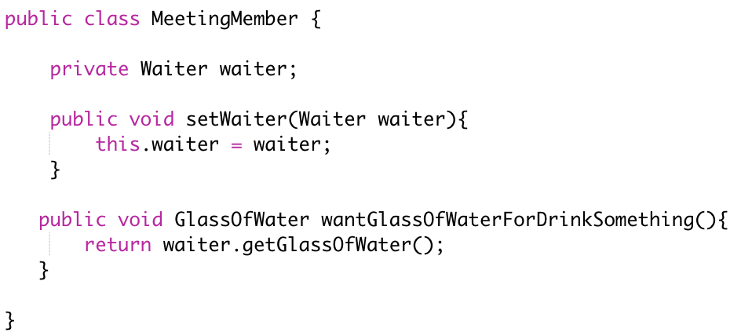
What is IoC (Inversion of Control)
There are differences between IoC and DI. IoC is a paradigm, DI is implementation of IoC by Spring Framework. Let’s take an example to understand what is IoC.
Let's say that we make some meeting in some hotel. Many people, many jugs of water, many plastic cups. When somebody wants to drink, he/she fills a cup, drink, and throw the cup on the floor. After an hour or something, we have a floor covered with plastic cups and water.
Let's invert the control now.
The same meeting in the same place, but instead of plastic cups we have a waiter with one glass cup (Singleton) and she/he all of the time offers to guests drinking.
When somebody wants to drink, she gets it from the waiter, drink, and return it back to the waiter. Leaving aside the question of the hygienic, the last form of drinking process control is much more effective and economic. And this is exactly what the Spring (another IoC container, for example: Guice) does.
Instead of let to application create what it need using new keyword (taking plastic cup), Spring IoC container all of time offer to application the same instance (singleton) of needed object(glass of water).
Think about yourself as an organizer of such meeting. You need the way to message to hotel administration that meeting members will need a glass of water but not a piece of cake.
Second Week
Spring IoC
Let’s write a better example of IoC.

Slide 13
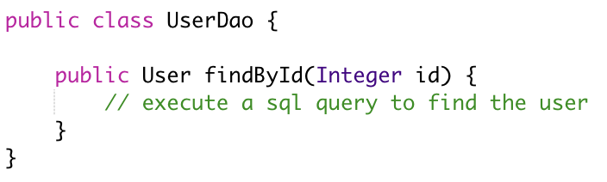
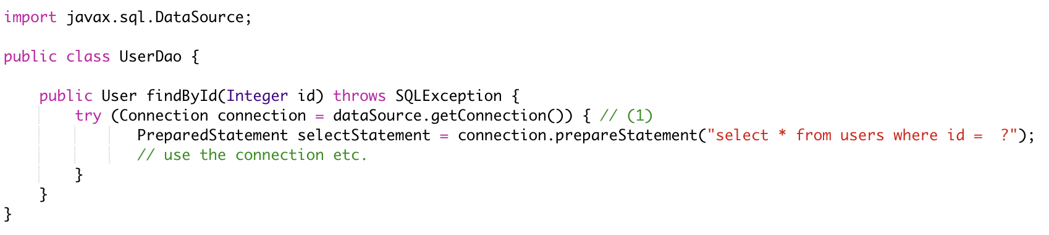
What is IoC (Inversion of Control)
Imagine you are writing a Java class that lets you access a users table in your database. You would call these classes DAOs (data access object) or Repositories. So, you are going to write a User DAO class.
Your User DAO has only one method which lets you find users in your database table by their respective IDs. To execute the appropriate SQL query, your User DAO needs a database connection. And in the Java world, you (usually) get that database connection from another class, called a Data Source. So, your code now would look something like this ;
Second Week
Spring IoC
1 - The question is now where does your User Dao get its Data Source dependency from? The DAO obviously depends on a valid Data Source to fire those SQL queries.

Slide 14
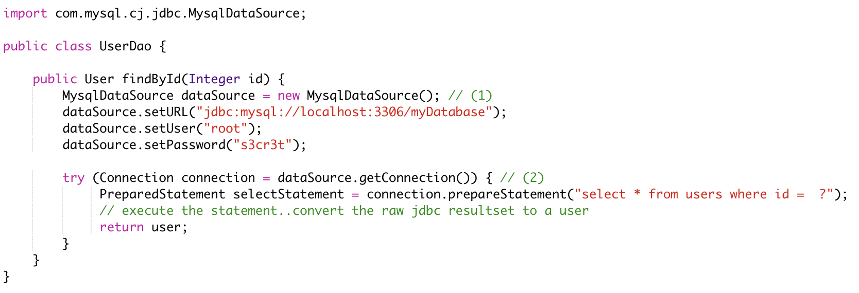
How to insantiate dependencies with new() keyword
The naive approach would be to simply create a new Data Source through a constructor, every time you need one. So, to connect to a MySQL database your User DAO could look like this
Second Week
Spring IoC
We want to connect to a MySQL database; hence we are using a MysqlDataSource and hardcoding URL/Username/Password here for easier reading.
We use our newly created Data Source for the query.

Slide 15
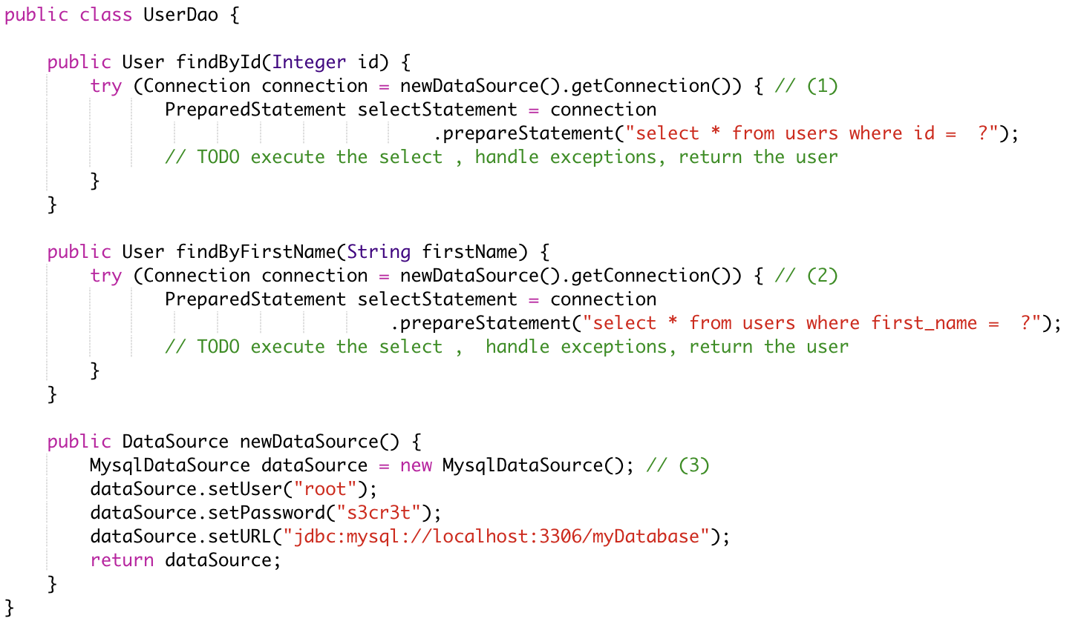
This works, but let’s see what happens when we extend our User Dao class with another method, findByFirstName.
Unfortunately, that method also needs a Data Source to work with. We can add that new method to our Use rDAO and apply some refactorings, by introducing a newDataSource method.
findById has been rewritten to use the new newDataSource() method.
findByFirstName has been added and also uses the new newDataSource() method.
This is our newly extracted method, able to create new DataSources.
This approach works, but has two drawbacks
What happens if we want to create a new ProductDAO class, which also executes SQL statements? Your ProductDAO would then also have a DataSource dependency, which now is only available in your UserDAO class. You would then have another similar method or extract a helper class that contains your DataSource.
We are creating a completely new DataSource for every single SQL query. Consider that a DataSource opens up a real, socket connection from your Java program to your database. This takes time and is rather expensive. It would be much nicer if we opened just one DataSource and re-used it, instead of opening and closing tons of them. One way of doing this could be by saving the DataSource in a private field in our UserDao, so it can be reused between methods - but that does not help with the duplication between multiple DAOs.
Second Week
Spring IoC

Slide 16
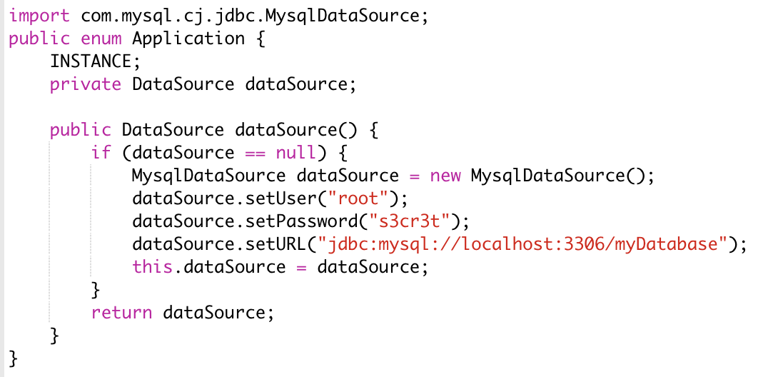
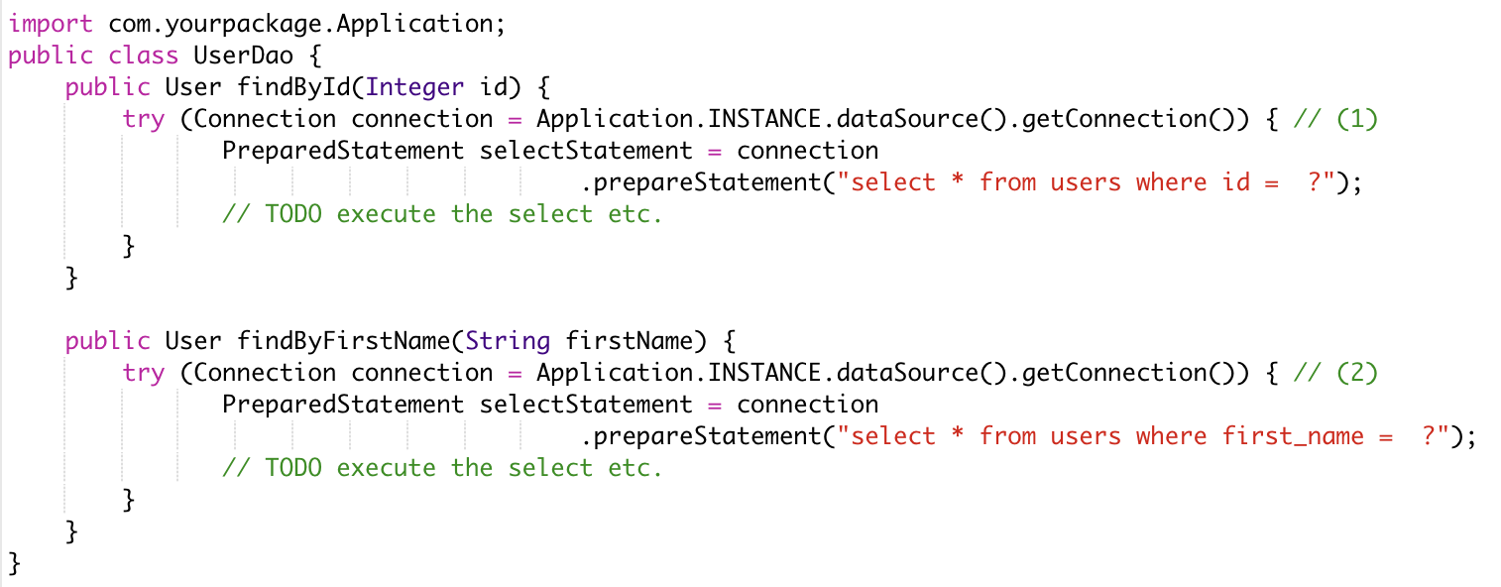
How to 'manage' dependencies in a global Application class
To accommodate these issues, you could think about writing a global Application class, that looks something like this
It is an improvement in two ways
Your UserDAO does not have to construct its own DataSource dependency anymore, instead it can ask the Application class to give it a fully-functioning one. Same for all your other DAOs.
Your application class is a singleton (meaning there will only be one INSTANCE created), and that application singleton holds a reference to a DataSource singleton.
Second Week
Spring IoC
There are however still several drawbacks to this solution
The UserDAO actively has to know where to get its dependencies from, it has to call the application class → Application.INSTANCE.dataSource().
If your program gets bigger, and you get more and more dependencies, you will have one monster Application.java class, which handles all your dependencies. At which point you’ll want to try and split things up into more classes/factories etc.
Your UserDAO could now look like this

